Slide 1
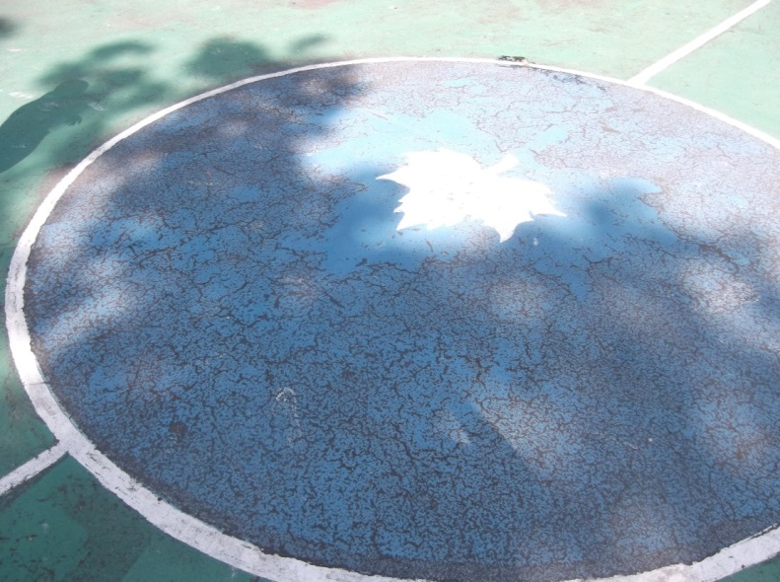
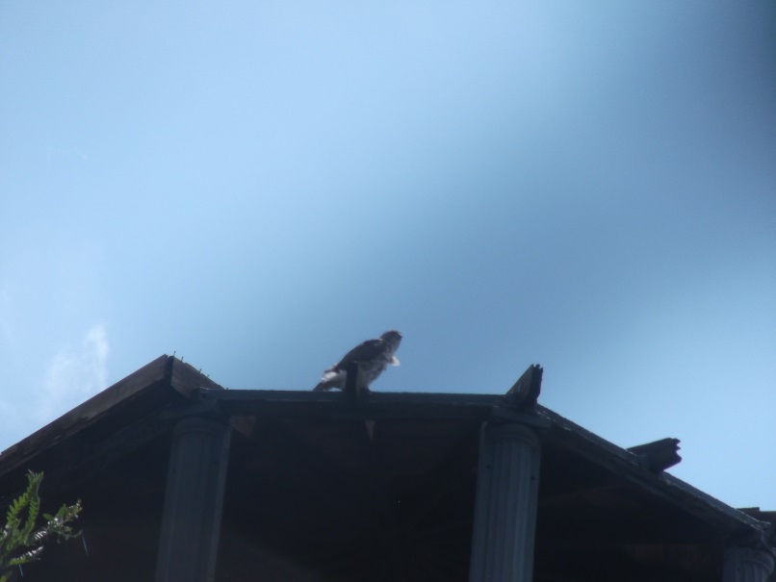
Harlem hawks
MARCUS GARVEY PARK

Slide 2
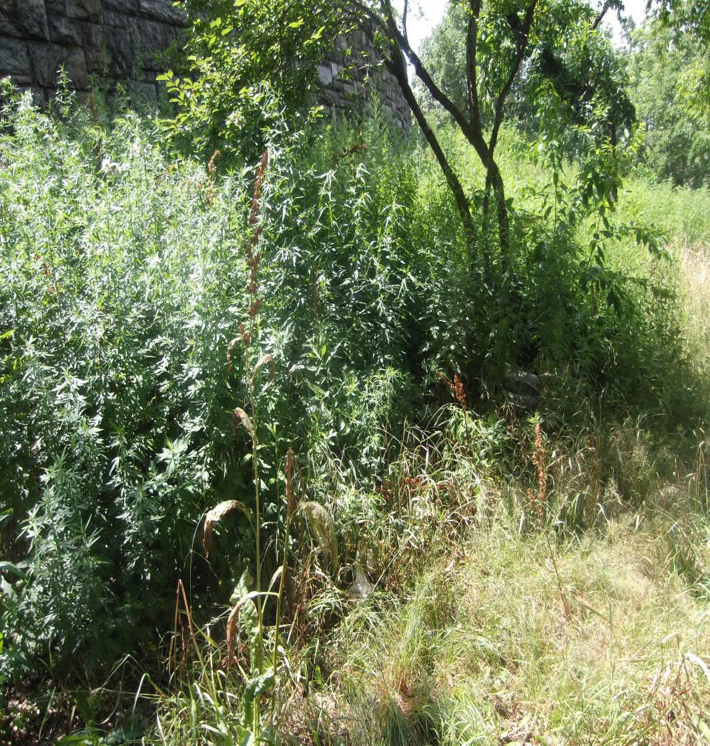
WEED WACKING

Slide 3
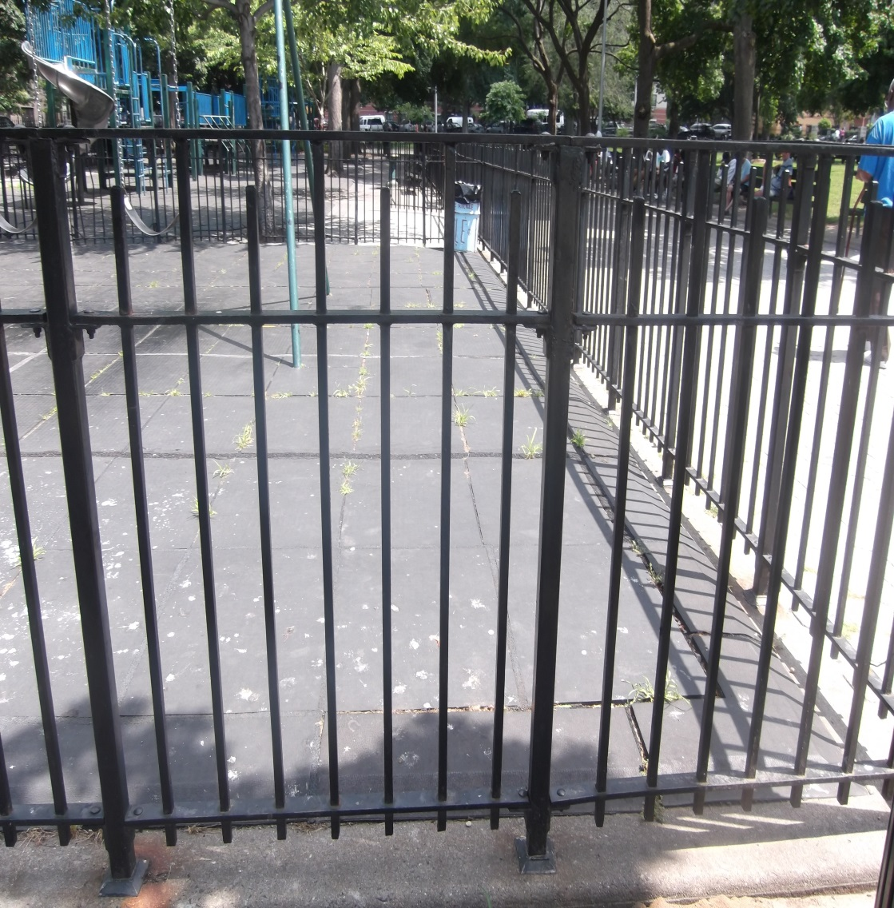
PAINTING AND RESTORATION

Slide 4
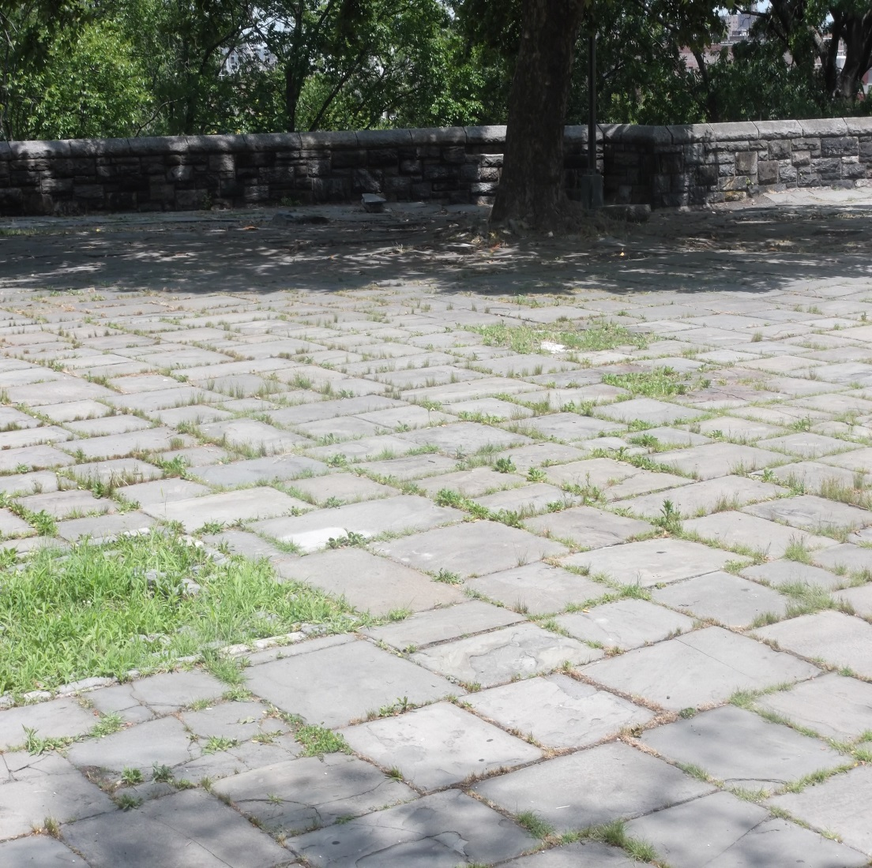
RAKING UP THE WEEDS

Slide 5
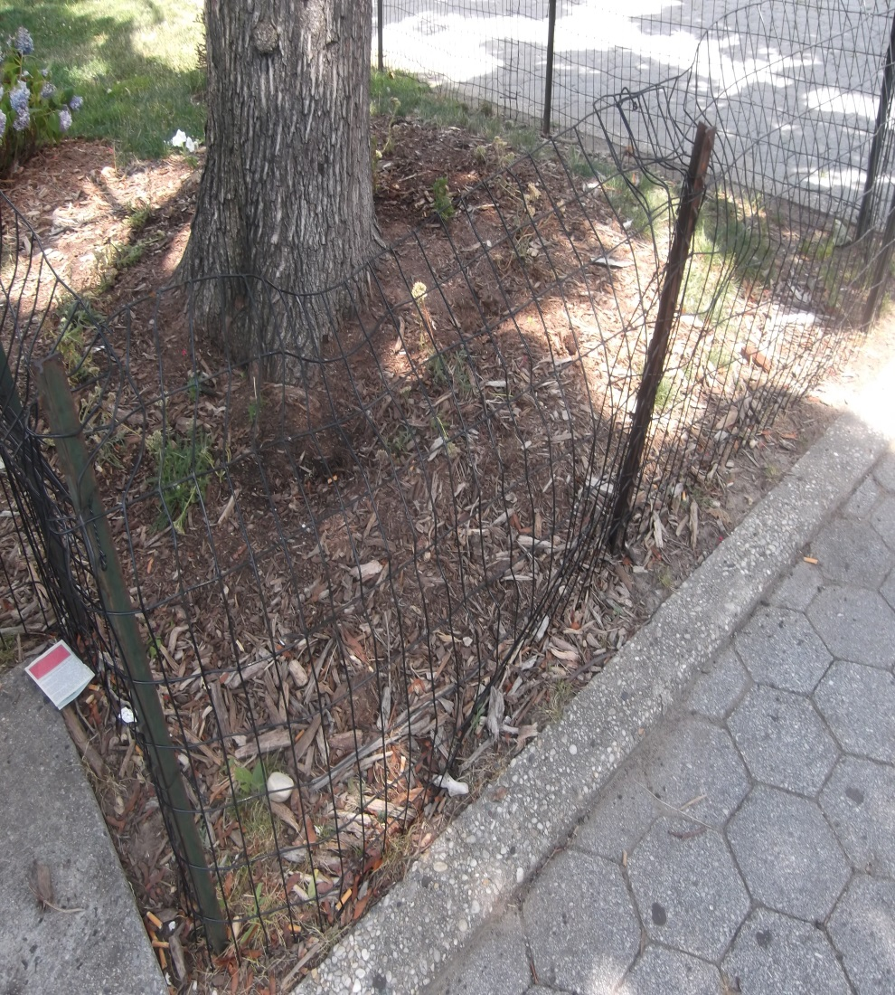
CLEANING UP NYC PARKS

Slide 6
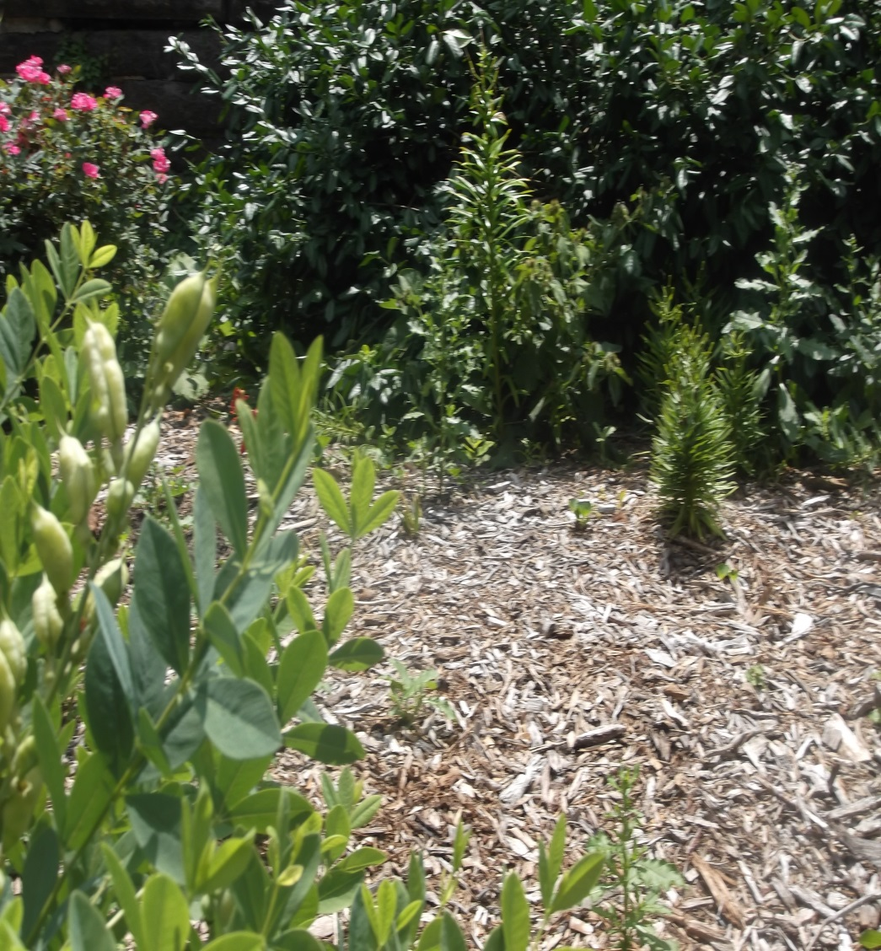
LANDSCAPING AND REPAIR

Slide 7
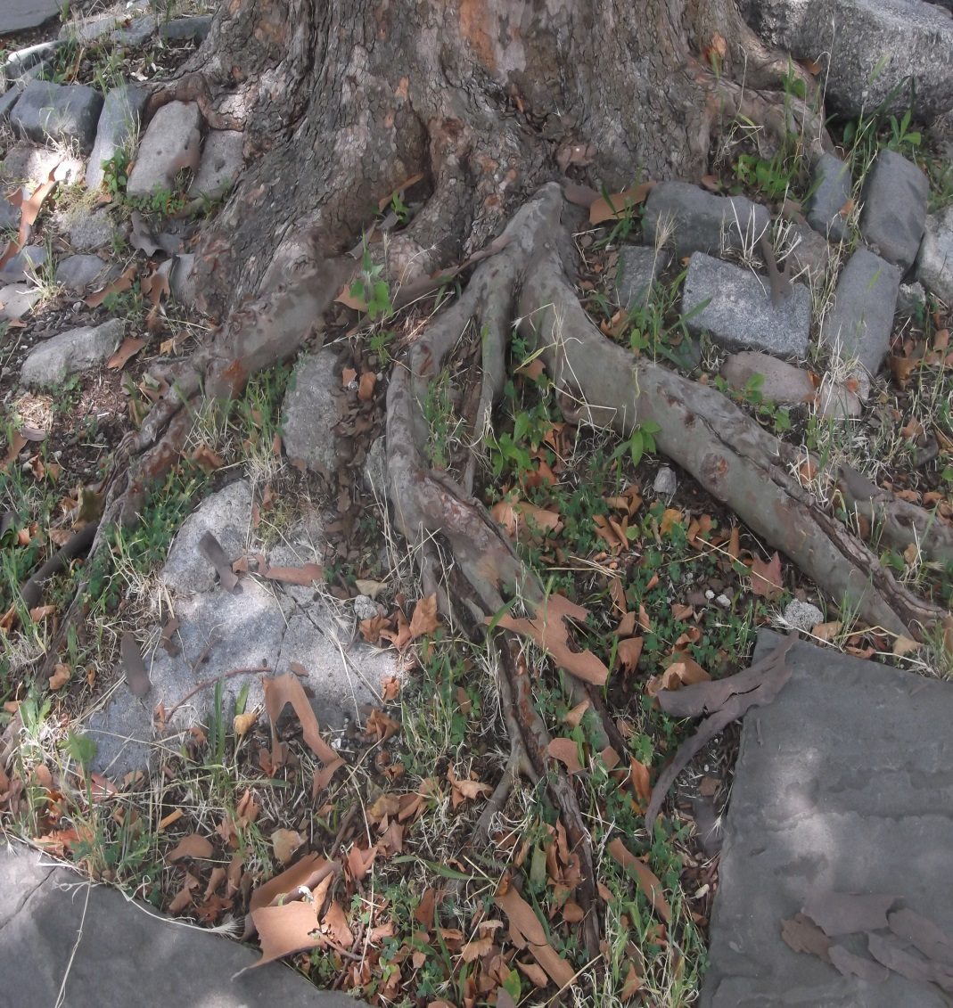
MULCHING AND MAKING A DIFFERENCE

Slide 8
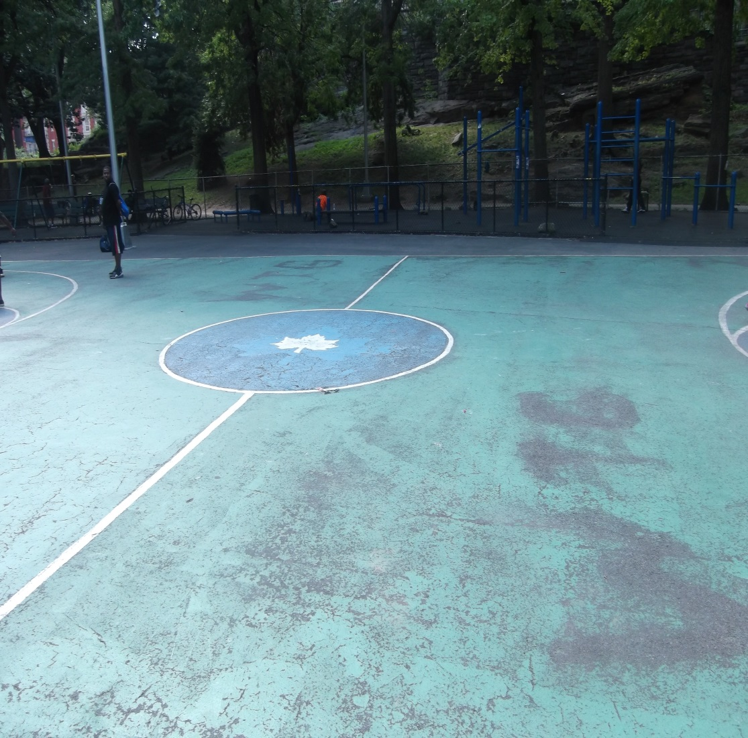
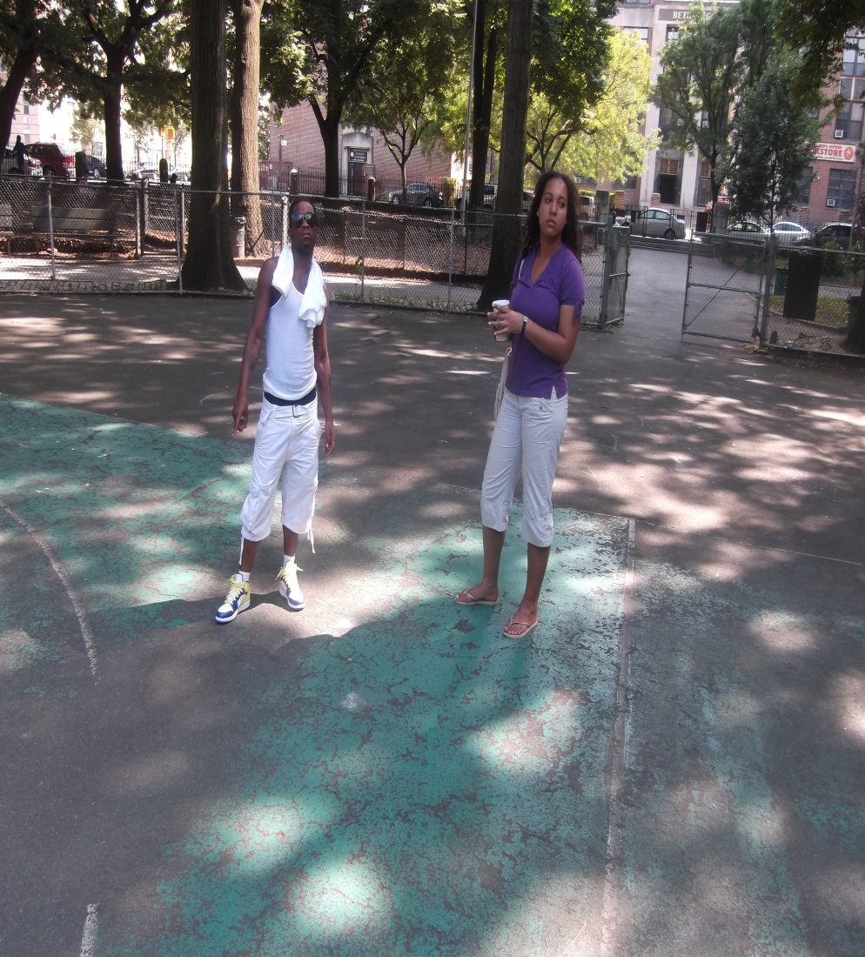
SPORTS COATING FOR OUR NEW GENERATION

Slide 9
“SWOOPING DOWN INTO HARLEM, HELPING OUR NEIGHBORHOOD TAKE FLIGHT!”
JESSICA
ESSIVI
NAJEE
EON
BAYRON
DOMINIQUE

Slide 10
Budget Sheet
Convener
Organization | Harlem Justice Corps
Project Name | Harlem Hawks
MATERIALS | UNIT COST | AMOUNT NEEDED | TOTAL COST (UNIT COST X AMOUNT NEEDED-IN KIND CONTRIBUTION=TC)
drop cloths | $7.33 | 3 | $21.99
9" roller trays | $3.56 | 5 | $17.80
4" flat brush | $9.86 | 10 | $98.60
2" flat brush | $6.67 | 10 | $66.70
gallon black paint | $32.72 | 10 | $327.20
gallon green paint | $32.72 | 10 | $327.20
gallon sports coating mix | $29.97 | 10 | $299.70
9" roller sleeves | $9.17 | 10 | $91.70
8 pack roller tray set | $10.96 | 1 | $10.96
goggles | $2.76 | 18 | $49.68
cooler | $24.99 | 1 | $24.99
water | $0.97 | 144 | $139.68
garden gloves | $2.00 | 18 | $36.00
roller handle | $6.00 | 10 | $60.00
scraper 2",3",4" | $2.98 | 6 | $17.88
ice | $2.00 | 56 | $112.00
 | total cost= |  | $1,563.69

